Slide 1
Bank Term Deposit Prediction Project
Fd39_101 – Fakruddin Ali Ahmed
fd39_103 – Shraddha s
Fd39_266 – Ayushi
Fd40_065 – Richa Kumari

Slide 2
Bank Term Deposit Prediction Project
This project focuses on predicting whether clients will subscribe to a term deposit using machine learning models. The dataset provided contains information on customer demographics, past interactions, and campaign outcomes. This repository includes the analysis, modeling, and insights obtained from the dataset.

Slide 3
Dataset Overview
age: Age of the client.
job: Job type (e.g., admin., technician, etc.).
marital: Marital status (e.g., married, single).
education: Level of education.
default: Has credit in default? (yes/no).
balance: Average yearly balance in euros.
housing: Has a housing loan? (yes/no).
loan: Has a personal loan? (yes/no).
contact: Communication type (e.g., cellular, telephone).
day: Last contact day of the month.
month: Last contact month of the year.
duration: Last contact duration in seconds.
campaign: Number of contacts performed during this campaign.
pdays: Days since the client was last contacted.
previous: Number of contacts performed before this campaign.
poutcome: Outcome of the previous marketing campaign.
y: Target variable (yes/no).

Slide 4
Problem Approach
Data Processing :
Handled missing values and encoded categorical variables.
Scaled numerical features for consistency.
Analyzed subscription rates, trends, and correlations.
Visualized key insights using Power BI.
Approximately 40000 rows and 17 columns.
Model Training:
Selected Random Forest Regression for its interpretability.
Split dataset into 80% training and 20% testing.
Assessed using accuracy , precision ,recall , and F1-Score .
Yes - 37104
No - 2896

Slide 5
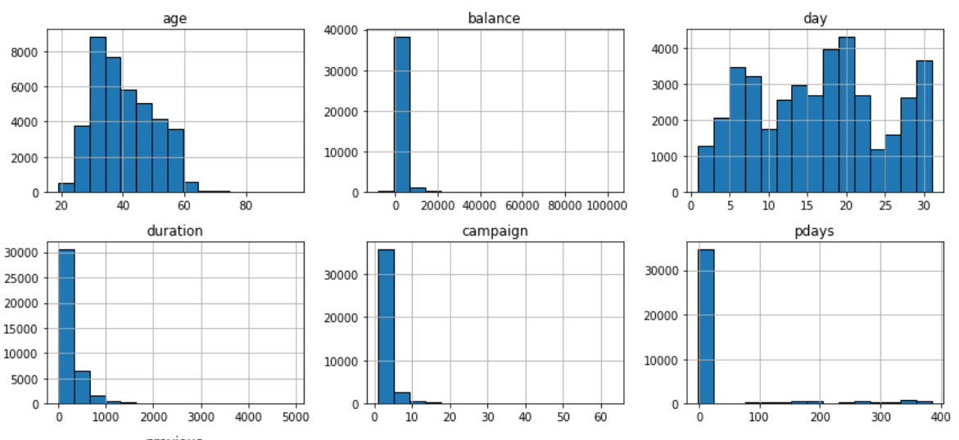
Histograms for numeric columns

Slide 6
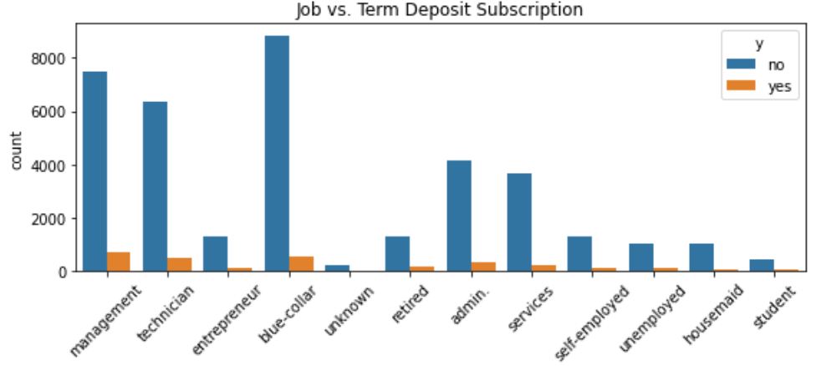
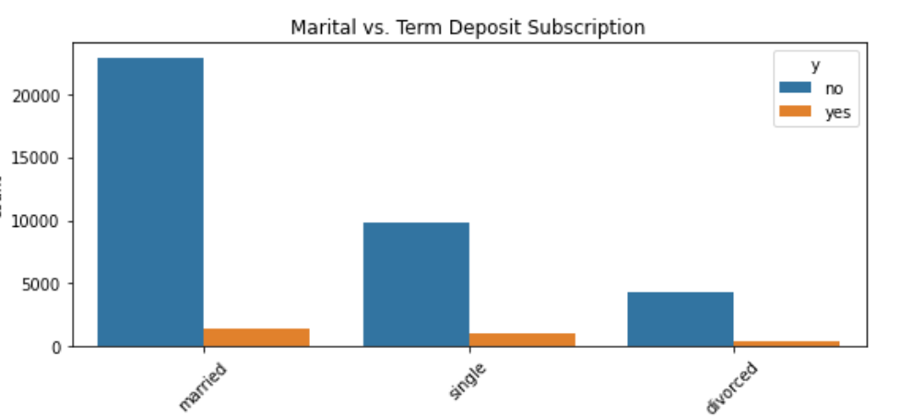
Team Deposit Subscription
Job vs Term Deposit Subscription
Marital vs Term Deposit Subscription

Slide 7
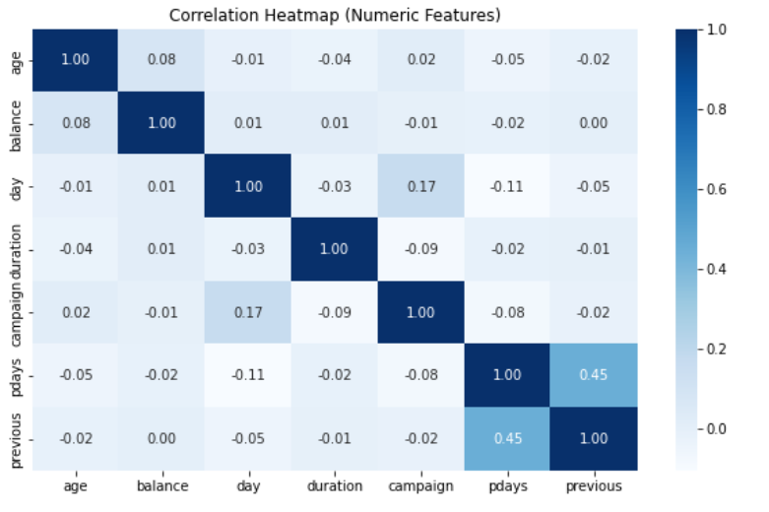
Correlation Matrix

Slide 8
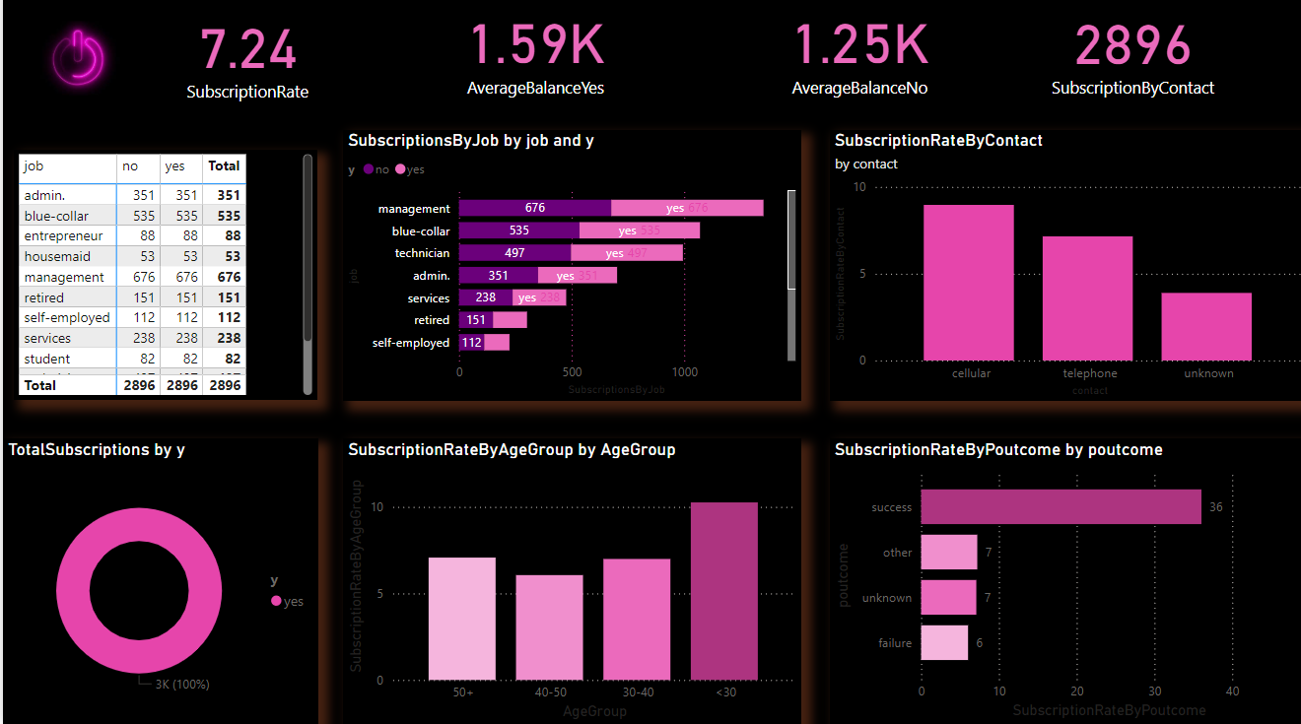
Power BI Analysis

Slide 9
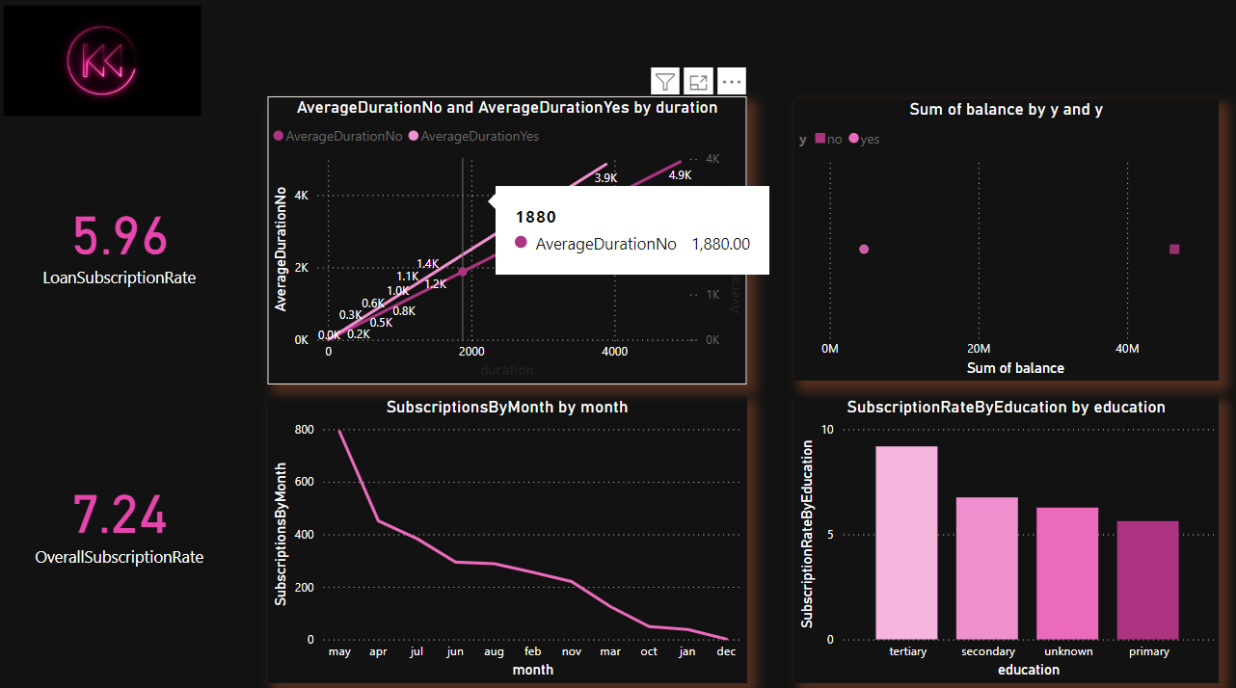
Duration “Yes” or “No”

Slide 10
Model Selection
Random Forest Regression
Handles complex relationships between features and target variables.
Reduces overfitting by averaging multiple decision trees.
Provides insights into feature importance.
Manages datasets with missing values effectively.
Suitable for high-dimensional and large datasets.
Combines multiple trees for improved accuracy and stability.
Performs well on both classification and regression tasks.
Balances bias-variance tradeoff effectively.

Slide 11
Model Output
Performance Metrics:
Accuracy: 0.938375
Precision: No - 0.95
Yes - 0.62
Recall: No - 0.98
Yes - 0.37
F1-Score: No - 0.97
Yes - 0.46
Predicted Y as a output
Model performs well on clients with clear patterns (e.g., high balance, positive previous outcomes).

Slide 12
Future Improvements
Experiment with advanced models like Logistic Regression and XGBoost.
Perform hyperparameter tuning for improved accuracy.
Explore SHAP values for deeper interpretability of model predictions.
Implement cross-validation to ensure model robustness.

Slide 13
Final Inference
Age groups (e.g., 30-50) and higher education levels positively influence subscriptions.
Longer call durations significantly increase subscription likelihood.
Successful outcomes in previous campaigns boost current campaign effectiveness.
Focus marketing efforts on target groups (e.g., specific age or job types)
Prioritize longer and more meaningful client interactions.
Leverage insights from previous successful campaigns.

Slide 14
Thank You

